Slide 1
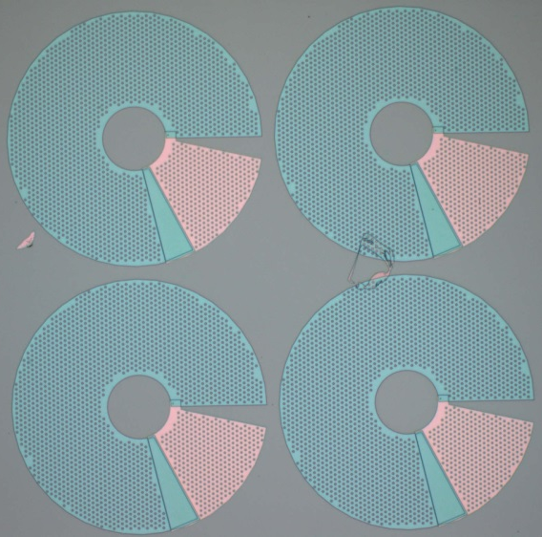








RF SQUID Metamaterials For Fast Tuning
Daimeng Zhang, Melissa Trepanier, Oleg Mukhanov, Steven M. Anlage
Phys. Rev. X (in press); arXiv:1308.1410
Fall 2013 MRS Meeting
2 December, 2013
NSF-GOALI ECCS-1158644
Notes:
15 Minutes including questions

Slide 2
Outline
Brief Introduction to Superconducting Metamaterials and SQUIDs
Design of our RF SQUIDs
Results (Tunability with Temperature, DC Flux, RF Flux)
Single RF SQUID
RF SQUID Array
Modeling and Comparison with Data
Tuning Speed
Future Work and Conclusions

Slide 3
Why Superconducting Metamaterials?
λ
The exciting applications of metamaterials:
Flat-slab Imaging
“Perfect” Imaging
Cloaking Devices
etc. …
… have strict REQUIREMENTS on the metamaterials:
Ultra-Low Losses
Ability to scale down in size (e.g. λ/10²) and texture the “atoms”
Fast tunability of the index of refraction n
Pendry (2004)
SUPERCONDUCTING METAMATERIALS:
Achieve these requirements!
Steven M. Anlage. "The Physics and Applications of Superconducting Metamaterials," J. Opt. 13, 024001 (2011).

Slide 4
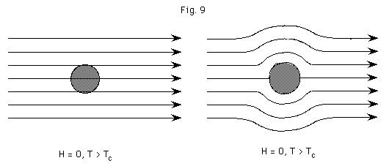
The Three Hallmarks of Superconductivity
Zero Resistance
Complete Diamagnetism
Macroscopic Quantum Effects
I
Flux Φ
V
T>T_{c}
T<T_{c}
DC Resistance
Magnetic Induction
B
0
T_{c}
0
Flux quantization Φ = nΦ₀
Josephson Effects
T_{c}
Temperature
Temperature

Slide 5
Macroscopic Quantum Effects
Superconductor is described by a single
Macroscopic Quantum Wavefunction
Consequences:
Flux Φ
Magnetic flux is quantized in units of Φ₀ = h/2e (= 2.07 x 10⁻¹⁵ Tm²)
R = 0 allows persistent currents
Current I flows to maintain Φ = n Φ₀ in loop
n = integer, h = Planck’s const., 2e = Cooper pair charge
I
superconductor
Example of Flux Quantization
One flux quantum in this loop requires a field
of B = Φ₀/Area = 1 μT = 10 mG
Earth’s magnetic field B_{earth} ~ 500 mG
50 μm
Superconducting
Ring

Slide 6
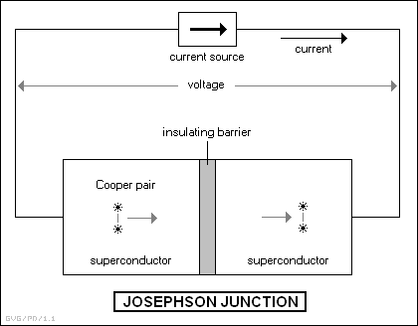
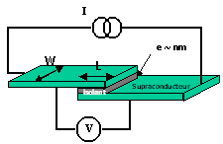
Macroscopic Quantum Effects
Continued
Josephson Effects (Tunneling of Cooper Pairs)
DC
AC
Circuit representation of a JJ
Gauge-invariant phase difference

Slide 7
Why Quantum
Josephson Metamaterials?
Josephson Inductance is large, tunable and nonlinear
Resistively and Capacitively Shunted Junction
(RCSJ) Model
Notes:
Josephson inductance derived: I = Ic sin(delta). Time-derivative: I. = Ic cos(delta) delta. = Ic (2e/h-bar) V cos(delta) Solve for V = LJ I., giving LJ = Phi_0/[ 2 Pi Ic cos(delta) ]

Slide 8
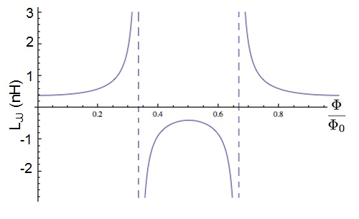


SQUIDs
rf SQUID
dc SQUID (NOT used here)
A Quantum
Split-Ring
Resonator
Operates in the voltage-state
Flux-to-Voltage transducer
V(Φ)
$$Φ$$
$$Φ$$
n = integer
Inductance of Junction in rf SQUID Loop
L_{geo}
L_{JJ}
R
C
Φ
Notes:
An rf SQUID is a superconducting loop interrupted by a single junction
As opposed to a DC SQUID which usually has two junctions and current leads
The net flux through the loop must be an integer number of flux quanta
So a DC field can induce a current in the loop
The current through the loop and associated phase difference will take on the value necessary to fulfill this requirement
On the bottom left I show the total current circulating through an rf SQUID loop as a function applied flux
There are SQUIDs for which this is not a single-valued function
But all of our SQUIDs are non-hysteretic
On the bottom right I show the Josephson inductance as a function of applied flux
It’s tunable over a wide range of values both positive and negative

Slide 9
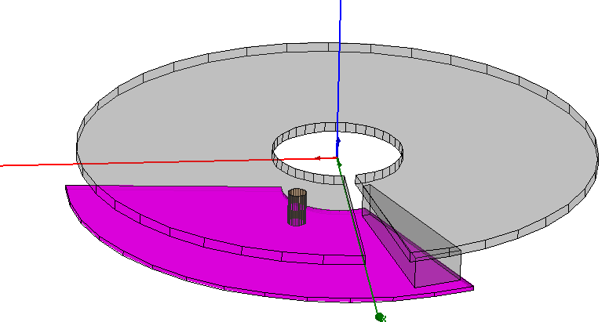
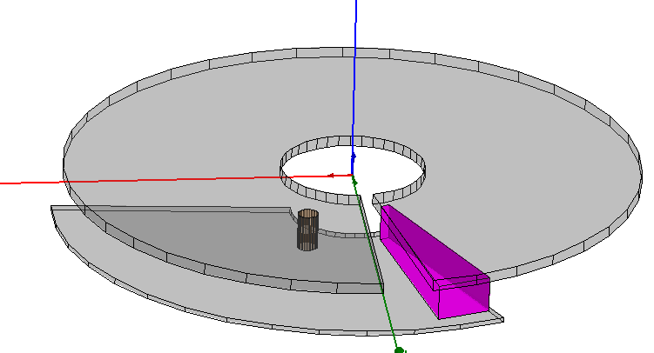
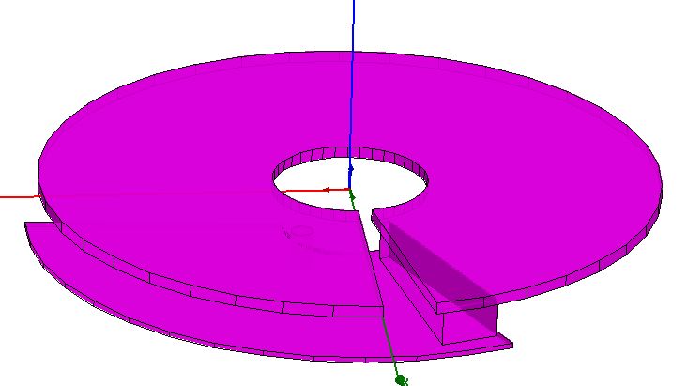
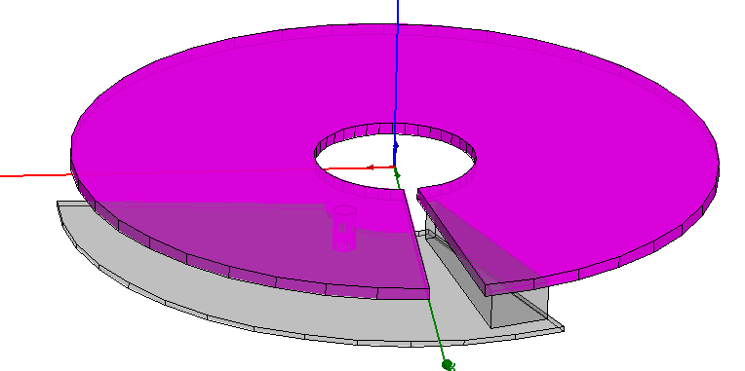
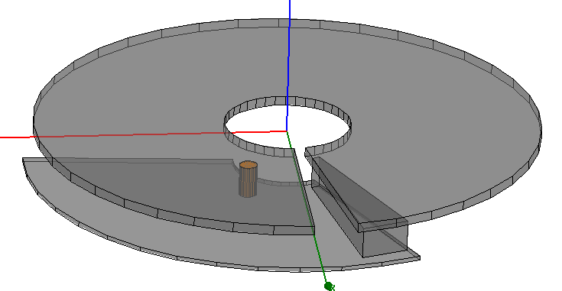
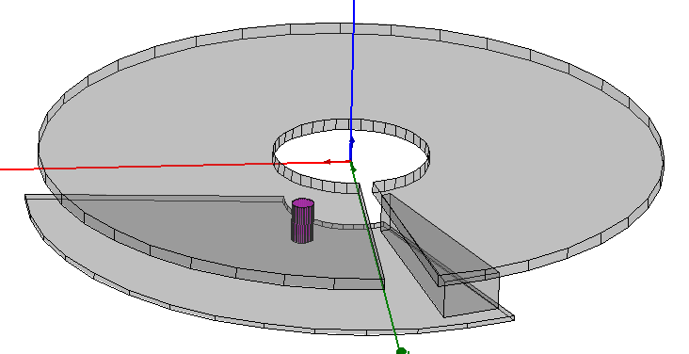
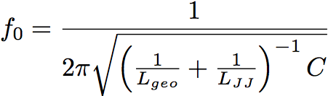
Example of our RF SQUID meta-atom
Niobium Layer 2
Nb: T_{c} = 9.2K
Junction
sc loop
Nb/AlO_{x}/Al/Nb
Via (Nb)
Overlap→ forms capacitor
Niobium Layer 1
L
L_{JJ}
R
C

Slide 10
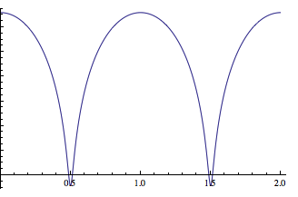

Tunable RF SQUID Resonance
resistivity and capacitively shunted junction model
L_{geo}
L_{JJ}
R
C
Φ
Tunability of RF SQUID Resonance
f₀ (GHz)
20
Potential Application:
Tunable band-pass filter for digital radio:
Multi-GHz tuning
Sub-ns tuning time scale
10
JJ switching on ~ ħ/Δ ~ ps time scale
Notes:
An Rf SQUID can be modeled as an RLC circuit
Using the resistively and capacitively shunted junction model
Applying a flux through the loop of the SQUID changes the JJL and has this effect on the resonant frequency

Slide 11
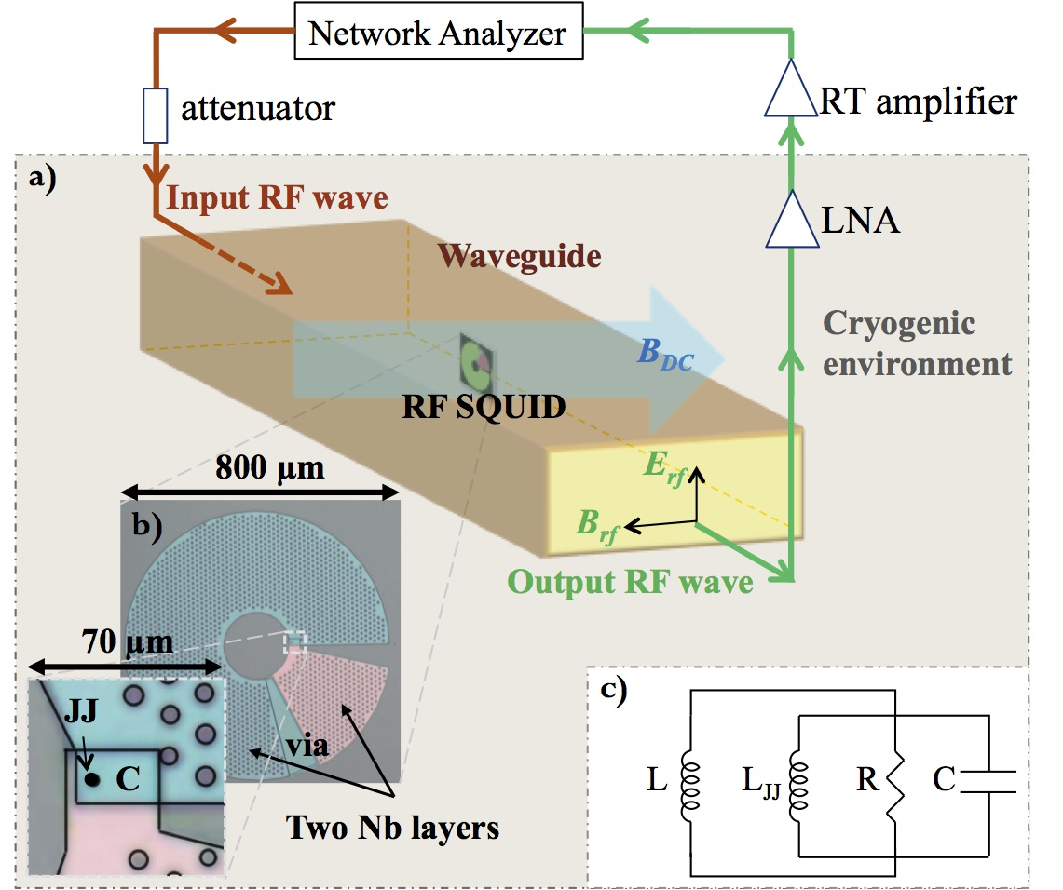
Experimental Setup
Transmission:
S₂₁ = V_{out}/V_{in}
S₂₁ (dB)
Nb/AlO_{x}/Al/Nb
Josephson
Junction
Frequency
Nb: T_{c} = 9.2K

Slide 12
Single-SQUID Tuning with DC Magnetic Flux
Comparison to model estimate
Tuning Range: 9.66 ~ 16.64 GHz
Δ|S₂₁|
Frequency (GHz)
Φ_{DC}/Φ₀
RF power = -70 dBm, @6.5K
See similar work by P. Jung, et al.,
Appl. Phys. Lett. 102, 062601 (2013)
Processed data

Slide 13
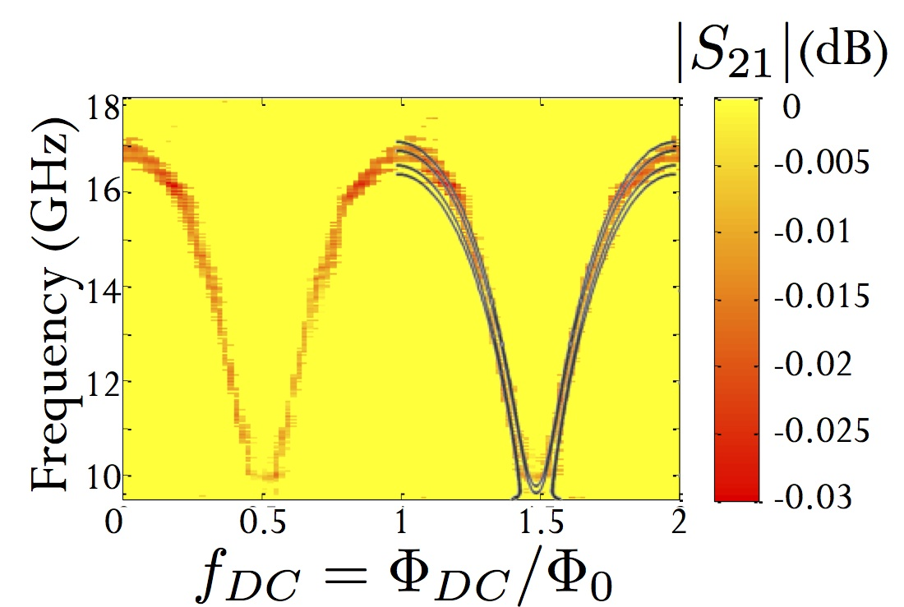
Single-SQUID Tuning with DC Magnetic Flux
Comparison to Model
RF power = -80 dBm, @6.5K
Maximum Tuning: 80 THz/Gauss @ 12 GHz, 6.5 K
Total Tunability: 56%

Slide 14




Modeling RF SQUIDs
Flux
Quantization
in the loop
L_{JJ}
L
I_{c}
R
C
Φ
I(t)
Solve for δ(t), calculate L_{JJ}, I(t), μ_{r}(f)
S₂₁ =
k =
arXiv:1308.1410

Slide 15
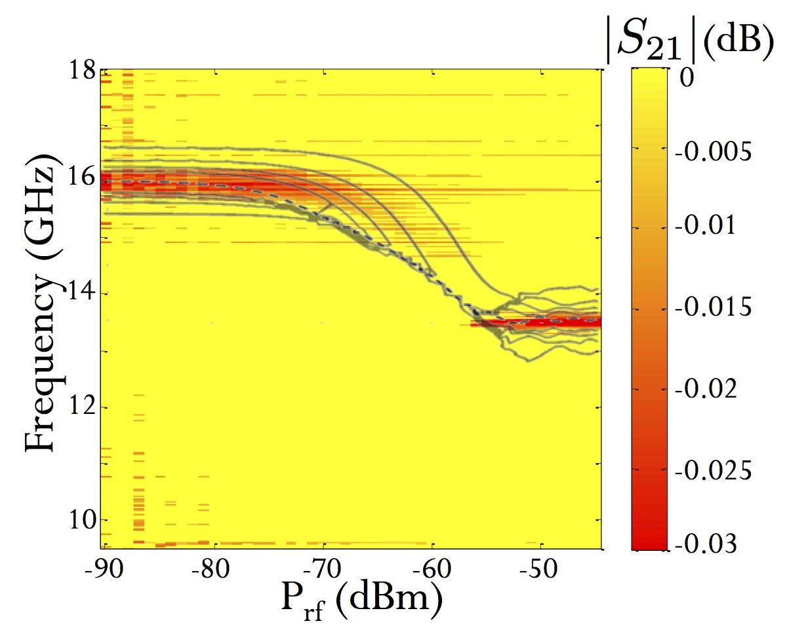
Single-SQUID Power Dependence
Power Sweep at nominal Φ_{DC} = 0
Comparison to full nonlinear model
Data and model agree that the single-SQUID “disappears” over a range of incident power
Transparency!
~ B_{RF}²

Slide 16
Nonlinear Model Calculation of RF Power Dependence
experiment
model
Frequency (GHz)
Transparency!
experiment
P_{rf} (dBm)

Slide 17

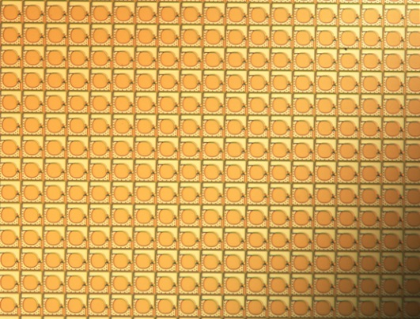
27x27 RF SQUID Array
Network Analyzer
attenuator
RT amplifier
a)
Input rf wave
Waveguide
LNA
Cryogenic
environment
B_{DC}
RF SQUID array
E_{rf}
Single RF SQUID
B_{rf}
output rf wave
2 Nb layers
JJ
via
λ / a ≈ 200
80 µm

Slide 18
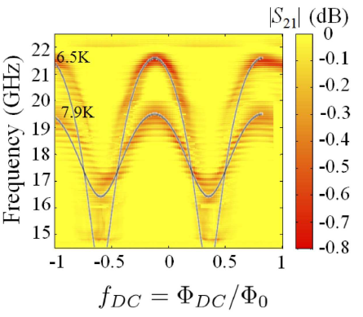
27x27 RF SQUID Array
DC magnetic flux tuned resonance
Coherent!
46% Tunability

Slide 19


Coherent Tuning of RF SQUID Array
For example, 2 coupled RF SQUIDs:
κ
κ
κ = M / L
κ=0.1
The coupled SQUIDs oscillate in a synchronized manner,
even when there is a small difference in DC flux (f_{DC})
Loop 1
Loop 2
The SQUID resonance blue-shifts with increased coupling,
or increasing the number of SQUIDs in the array
κ=0.2
B_{app}
B_{app}
B_{c}
B_{c}
I
I
B_{ind}
B_{ind}

Slide 20
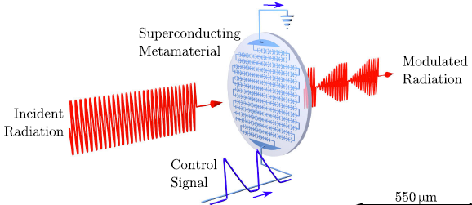
Speed of RF SQUID Meta-Atom Tunability
Upper limit: Shortest time scale for superconductor switching is ħ/Δ ~ 1 ps
Circuit Time scales:
L/R ~ 0.5 ps
RC ~ 0.3 ns
Temperature Tuning:
Generally slow, depending on heat capacity and thermal conductivity
Tuning speed ~ 10 μs
see e.g. V. Savinov, et al. PRL 109, 243904 (2012)
RF Flux Tuning:
Pulsed RF measurements show response time < 500 ns
Quasi-static Flux Tuning:
ns-tuning frequently achieved in SQUID-like superconducting qubits
see e.g. Paauw, PRL 102, 090501 (2009); Zhu, APL 97, 102503 (2010)

Slide 21
Future Work
JJ wire + SQUID metamaterials for n < 0
Calibrate the cryogenic experiment to extract µ, ε of our metamaterials [J. H. Yeh, et al. RSI 84, 034706 (2013)]
Further investigate nonlinear properties of SQUID metamaterials
  Bistability in β_{RF} < 1 RF SQUIDs
  Multistability in β_{RF} > 1 RF SQUIDs
  Intermodulation and parametric amplification in SQUID arrays

Slide 22

Conclusions
Successful design, fabrication and testing of RF SQUID meta-atoms and metamaterials
Periodic tuning of resonances over 7+ GHz range under DC magnetic field ~ mGauss.
∆f/∆B ~ 80 THz/Gauss (max) @ 12 GHz, 6.5 K
SQUID meta-atom and metamaterial behavior understood from first-principles theory
RF SQUID array tunes coherently with flux → synchronized oscillations
Metamaterials with greater nonlinearity are possible!
Phys. Rev. X (in press); arXiv:1308.1410
Thanks for your attention!
anlage@umd.edu
NSF-GOALI ECCS-1158644
Thanks to A. V. Ustinov, S. Butz, P. Jung @ Karlsruhe Institute of Technology
and M. Radparvar, G. Prokopenko @ Hypres
Steven M. Anlage. "The Physics and Applications of Superconducting Metamaterials," J. Opt. 13, 024001 (2011)

